Slide 1

Tableau

Slide 2
Data Analysis Can be boring
Searching for/obtaining data
Cleaning the data, you must make it “workable”
Analyzing & finding your answers
Trying to explain to people who don’t understand what you’ve found
YOU HAVE TO MAKE IT INTERESTING!
You WANT to be able to tell your STORY!

Slide 3
What is Tableau?
A very powerful data visualization software that helps people view and understand data.

Slide 4
It makes it easier for people to explore and manage their data.
It can be a central location for data from several sources
It will change raw data into data that is easy to understand
It is growing really fast as a key data analytics platform.
There’s a HUGE community of Tableau users
No coding necessary

Slide 5
Possible Job Titles
Business Analyst
BI Engineer
Data Analyst
BI Analyst
BI Developer
Verizon
Lenovo
Chipotle
REI
Charles Schwab

Slide 6
As a Data Analyst
You are required to manipulate the data in a tabular and systematic form to help solve some challenges that your company might be facing.
Business analytics, the importance of data visualization and how to utilize Tableau.

Slide 7
Business intelligence
The right information to the right people at the right time to aid in better decision making.
Business Analytics
Data mining
Data visualization
Data tools
Infrastructure

Slide 8
Examples
Identify ways to increase profit
Track performance
Analyze customer behavior
Compare data with competitors
Discover issues or problems
Optimize operations
Recognize trends
Predict range of successes

Slide 9

Data visualization
Uses pictures to represent data
Most effective way to communicate
LOTS of tools available
Allows for quantitative data to be viewed easier & better decisions made quickly

Slide 10



Slide 11
With tableau
Can utilize data in various forms (except for Tableau Public)
No technical or programming experience required
You can data blend (connect multiple sources for one analysis using joins)
Analyze in real-time
Collaborate with other team members

Slide 12
Advantages
Scripting language
Data Visualization
Quick Insights
Large amounts of data
Easy Implementation
Responsive Dashboard
Disadvantages
Restrictive Imports
Custom Formatting
Static Parameter
Screen Resolution
Scheduling Reports

Slide 13
Tableau Public
Can load from 9 different data sources
Tableau Desktop
Can load from 77 different data sources

Slide 14
Opening tableau public
Connect Pane: where various data sources can be connected
Open Pane: where you can see recently opened files/sample dashboards
Discover Pane: helps you connect with the Tableau Community and access videos and blogs.

Slide 15
Click on Microsoft excel open Sample – Superstore click/drag “orders” over to the white area on the right

Slide 16
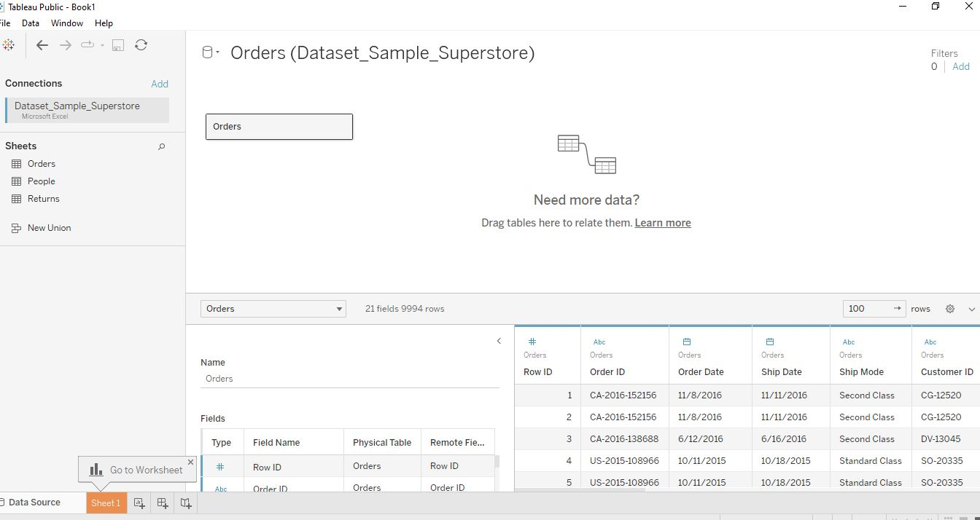

Slide 17
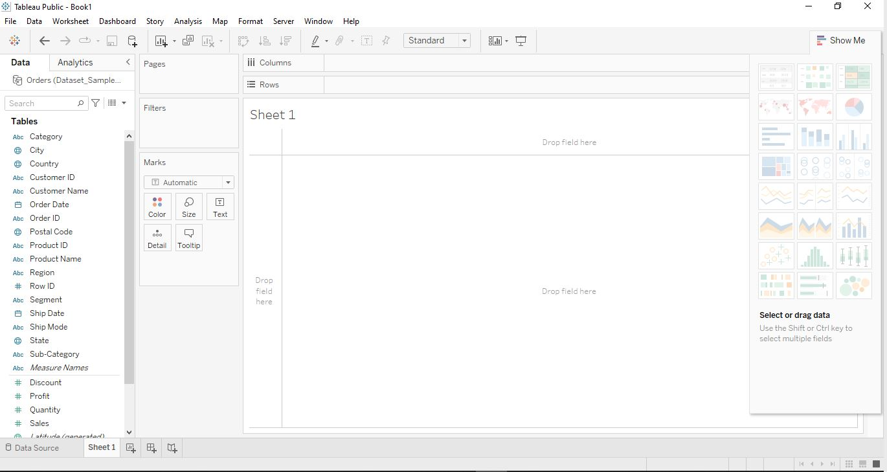
Quick Access Toolbar
D
A T A
P A N E

Slide 18
Tableau breakdown
Each graph should require a NEW worksheet & make sure they are named properly
Dashboards are preps for your STORY (aka presentation)
Think of each Dashboard as a “slide” where you put your STORY together. Make sure to name them properly
Your STORY is your presentation of how you want to show your Dashboards (aka slides)

Slide 19
Let’s practice
Plot SALES against CATEGORY, SEGMENT & ORDER DATE
Make it a line graph
Filter down to Home Office for each segment
Delete top title
Make it a bar graph
Rename it “Home Office Sales”

Slide 20
8 tools to prepare data for analysis
Joins
Relationships
Unions
Data Blending
5. Aggregations
6. Pivot
7. Data Interpreter
8. Split

Slide 21
joins
Combine data in order to filter and get rid of duplicates
Left Join
Right Join
Inner Join
Full Outer Join

Slide 22
Connect to the Sample-Superstore dataset
Move “Orders” over to the canvas
Right-click on “Orders” and click Open
Move “Returns” over to the canvas
This creates an inner join BY DEFAULT
Select the correct join

Slide 23
Tableau will identify the primary key for joining two or more data sets together
Left Join: values from LEFT Table & match to RIGHT Table
Right Join: values from RIGHT Table & match to LEFT Table
Inner Join: includes common data present in BOTH datasets
Full Outer Join: includes ALL values from both tables.

Slide 24
Relationships
Created when you drag more than one sheet over
Think of it as a contract between two tables
No joining
Automatic & context aware
Flexible

Slide 25
Joins versus relationships

Slide 26
unions
Helps bring together data from multiple small files into one large one.
Connect to dataset
Drag over needed sheet
Drag over another to overlap (you’ll see “union”)
Overlapping icon

Slide 27
Data blending
Tableau combines related data from multiple sources in a single view
Connect two sources (Superstore & Global Superstore)
Click on Data table & “Edit Blend Relationships”
Choose “Segment” and “OK”
Drag “Profit” from both sets over to Columns
Drag “Segment” from Global Superstore over to Rows

Slide 28
BLEND
Used to combine data from different databases that don’t support joins
Data w/in databases are at different levels of detail
Joins = duplicate rows
Involves large amount of data
JOIN
Data format is consistent across ALL sources
Involves small amounts of data
Data is at the same level of detail across sources

